Slide 1
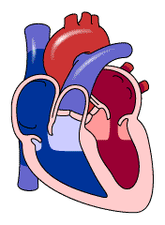
MKU
School of Medicine
MBMP 1323 : Cardiovascular Physiology I
Topic: The cardiac Muscles
By J. Alfred, BSc, MSc, MA, PhD cont.
Email: alfredjuma2015@yahoo.com

Slide 2
CARDIAC MUSCLE
Heart is composed of three major types of cardiac muscle
Atrial Muscle
Ventricular Muscle
Specialize Excitatory & Conductive Muscle
The atrial and ventricular muscle contract in much the same way as skeletal muscle, except duration of contraction is much longer.
The specialized excitatory and conductive fibers contract weakly because they contain few contractile fibrils Guyton pp 109

Slide 3

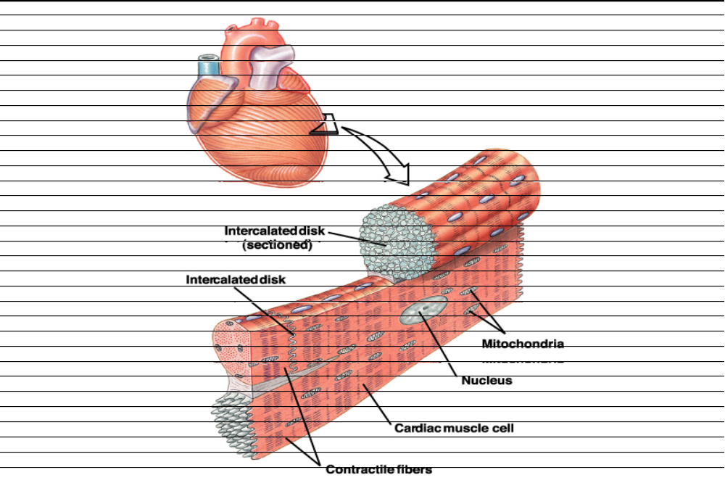
Cardiac muscle fibers are striated in appearance
Functional unit is called Sarcomere
Fibers are branched; connect to one another at intercalated discs.
The discs contain several Gap Junctions
Nuclei are centrally located
Abundant Mitochondria
Sarcoplasmic Reticulum is less abundant than in skeletal muscle, but greater in density than smooth muscle
Sarcolemma has specialized ion channels that skeletal muscle does not – voltage-gated Ca2+ channels
Fibers are not anchored at ends; allows for greater sarcomere shortening and lengthening

Slide 4
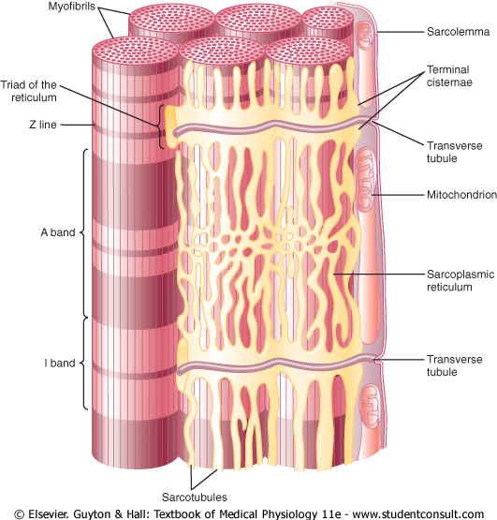
CARDIAC MUSCLE

Slide 5
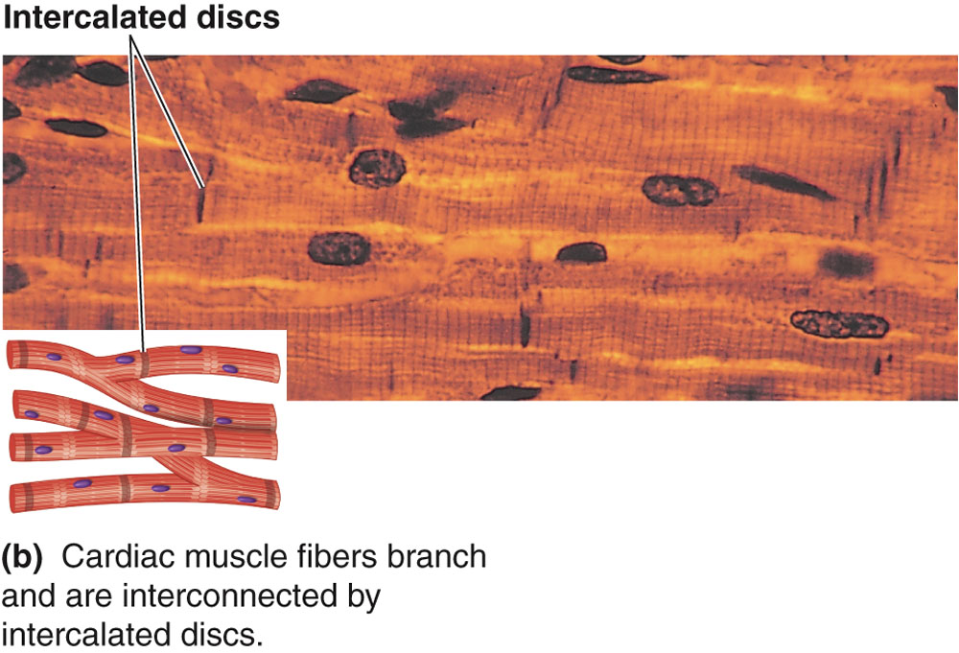
CARDIAC MUSCLE
The dark areas crossing the cardiac muscle fibers are called intercalated discs; they are actually cell membranes that separate individual cardiac muscle cells from one another.
Guyton pp 109

Slide 6
CARDIAC MUSCLE
At intercalated disc cell membranes fuse with one another, form permeable “communicating” junctions (gap junctions) allow free diffusion of ions.
Ions move with ease in the intracellular fluid along the longitudinal axes of the cardiac muscle fibers, so that action potentials travel easily from one cardiac muscle cell to the next
Thus, cardiac muscle is a syncytium of many heart muscle cells, action potential spreads to all of them.
Guyton pp 104

Slide 7
isometric contraction: Muscle contraction without significant shortening or change in distance
isotonic contraction: Muscle contraction without significant change in the force of contraction

Slide 8
Interconnected by intercalated discs and form functional syncytia
Within intercalated discs – two kinds of membrane junctions
  Desmosomes
  Gap junctions

Slide 9
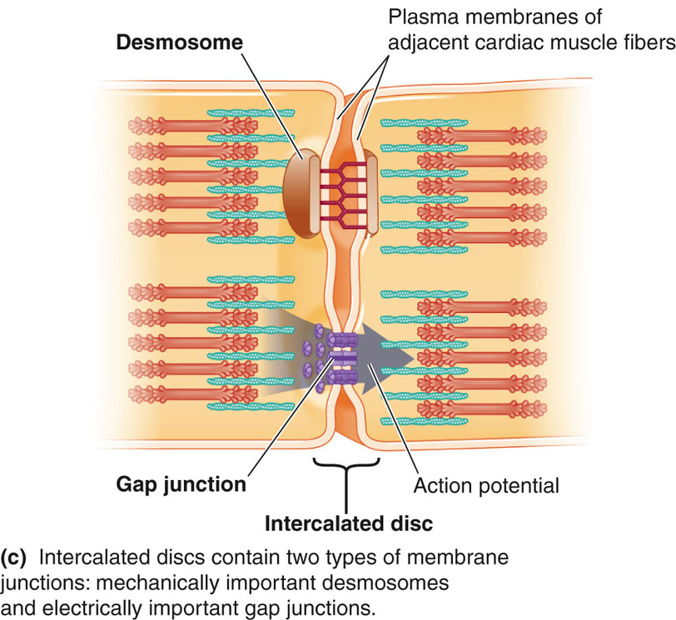
CARDIAC MUSCLE

Slide 10
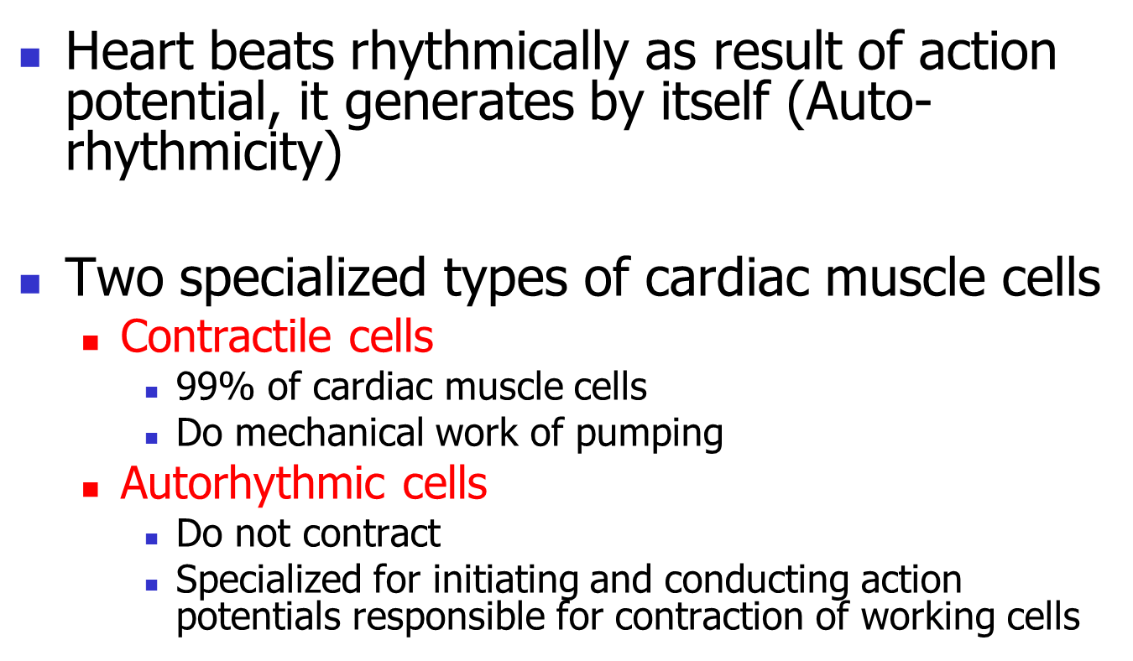
CARDIAC MUSCLE

Slide 11
CARDIAC MUSCLE PROPERTIES
  The cardiac muscle cells are responsible for the electrical stimulation leads to mechanical function. The electro-physiologic properties of cardiac muscles are:
  Automaticity: Ability to spontaneously generate an electrical impulse.
  Excitability: Ability to respond to an electrical impulse.
  Conductivity: Allows transmission of electrical impulse to another cardiac cell.
  Contractility: Ability to contract after electrical impulse response
  Rhythmicity: Ability to send electrical impulses in a regularly manner.

Slide 12
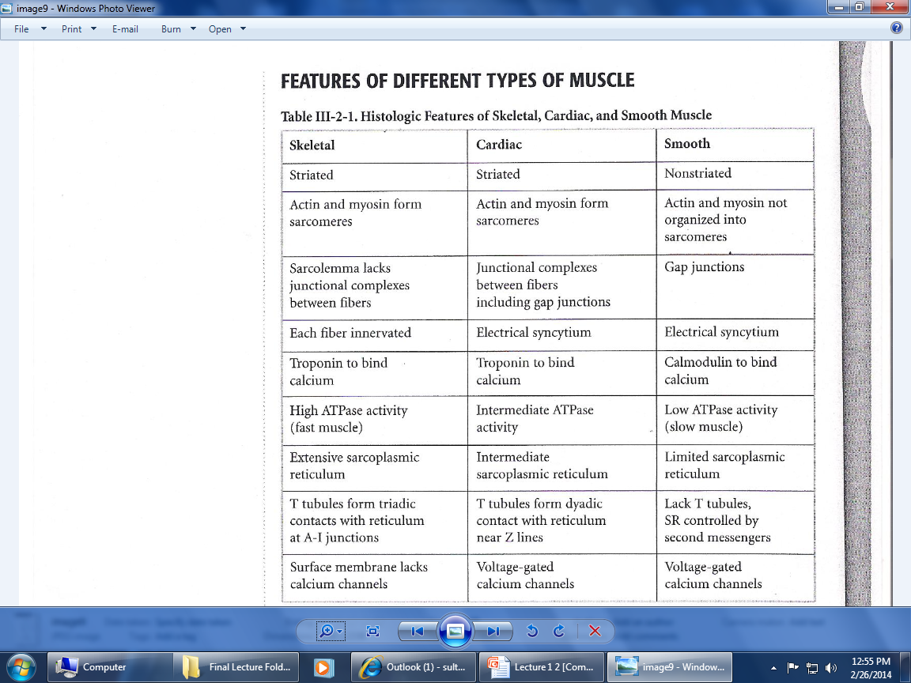

Slide 13
Excitation-Contraction coupling
Excitation-Contraction coupling
[ Ca⁺⁺ ]_{i}
Contraction
Excitation
(Action Potentials)
(shortening)

Slide 14

Excitation of the heart is triggered by electrical impulse rather than neural transmitters.
Contraction of the heart is triggered by elevation of intracellular calcium influx.
[ Ca⁺⁺ ]_{i}
Contraction
Excitation
(Action Potentials)
(shortening)

Slide 15
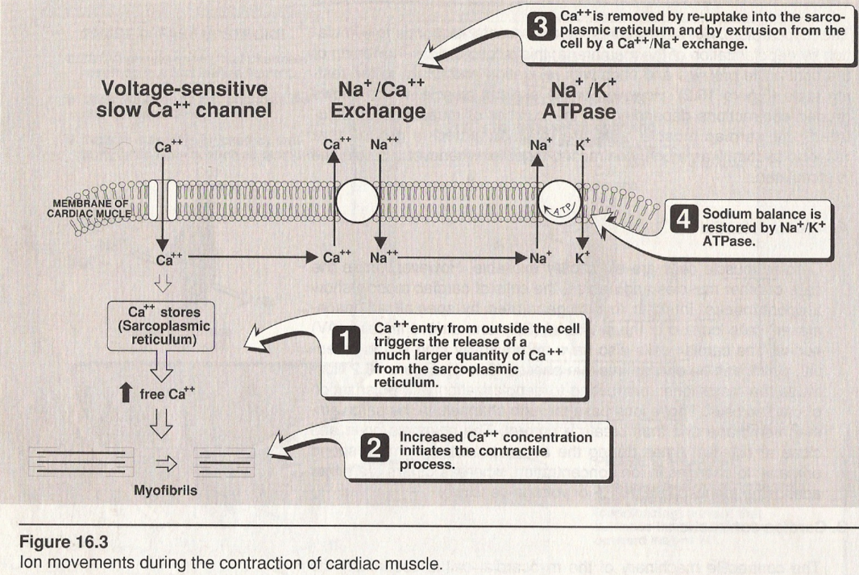

Slide 16
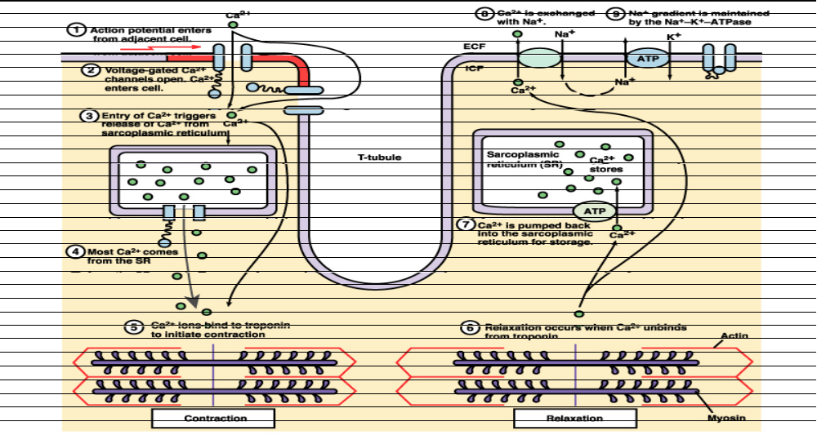
Excitation-Contraction coupling
Calcium ions regulate the contraction of cardiac muscle:
Entry of extracellular calcium ions causes the release of calcium from the sarcoplasmic reticulum (calcium-induced calcium release), source of about 95% of calcium in cytosol.

Slide 17
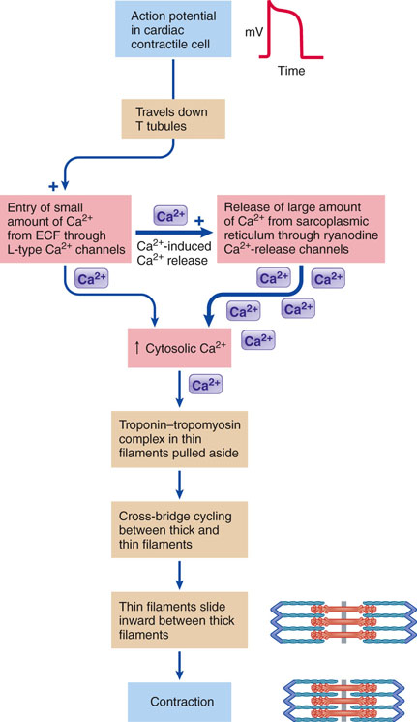
Excitation-Contraction Coupling in Cardiac Contractile Cells

Slide 19
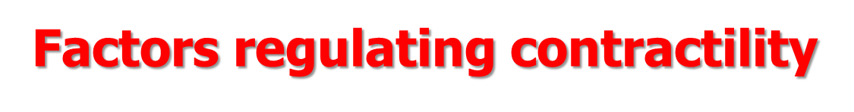
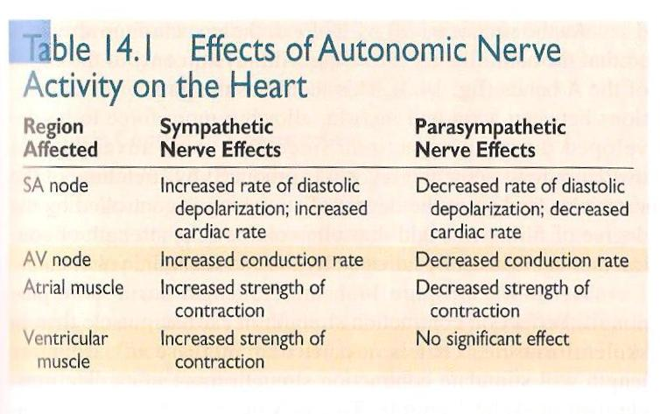

Slide 20

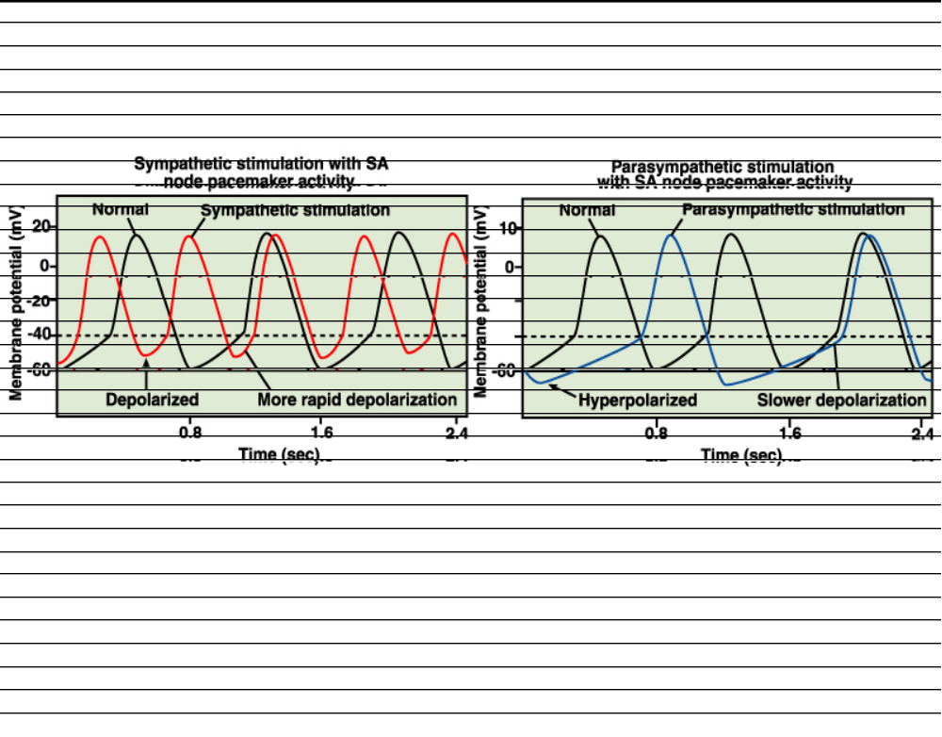
Autonomic nervous system modulates the frequency of depolarization of pacemaker
Sympathetic stimulation (neurotransmitter); binds to b1 receptors on the SA nodal membranes
Parasympathetic stimulation (neurotransmitter); binds to muscarinic receptors on nodal membranes; increases conductivity of K+ and decreases conductivity of Ca2+

Slide 21
THANK YOU

